Slide 1





IILM UNIVERSITY
CANDIDATE INFORMATION
Greater Noida, Uttar Pradesh
Mohammad Amaan Aslam
ROLL NUMBER
ACADEMIC BATCH
2410030089
2026–2027
NetSage AI: AI Deployment & Automation
For Cisco Network Troubleshooting
FACULTY MENTOR
Prof. Swati Vashisht
DEGREE & DEPARTMENT
Instructor, IILM University & Cisco Networking Academy
B.Tech (CSE) — School of Computer Science & Engineering

Slide 2



Candidate Declaration & Academic Details
Student Profile
Project Verification
STUDENT NAME
PROJECT TITLE
Mohammad Amaan Aslam
NetSage AI: AI Deployment & Automation for Cisco Network Troubleshooting
ROLL NUMBER
2410030089
SPONSORING PLATFORM
DEGREE PROGRAM
Cisco Networking Academy Virtual Internship
Bachelor of Technology (B.Tech) in CSE
FACULTY SUPERVISOR
ACADEMIC SESSION
Prof. Swati Vashisht
2026–2027 Batch
DECLARATION SCOPE
INSTITUTION
Original work completed in partial fulfillment of B.Tech (CSE) degree
IILM University, Greater Noida, U.P.

Slide 3


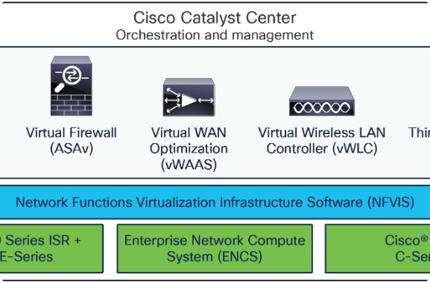
Sponsoring Organization: Cisco Networking Academy
Global Technical Skill Leader: Cisco Networking Academy provides structured IT, networking, cybersecurity, and modern AI curricula worldwide.
Academic Partnership with IILM: Direct collaboration providing hands-on lab environments and virtual internship projects to engineering undergraduates.
Emerging AI & Automation Domain: Focuses on integrating modern AI frameworks with network telemetry, CLI diagnostics, and deterministic modeling.
Industry Standard Tools: Hands-on training utilizing Cisco Packet Tracer, Cisco IOS CLI, Python automation scripts, and LLM prompt engineering.

Slide 4


Problem Statement: Multi-Layer Diagnostic Friction
Root-Cause Isolation Challenge
Operational Risk of Unchecked AI
Junior network engineers frequently know isolated CLI commands but struggle to connect symptoms to exact root causes in multi-layer network environments (L1 to L7).
Fully autonomous AI models present severe enterprise risks if permitted to execute unverified CLI changes directly on production network infrastructure.
When a host gets an IP but cannot reach a server, pinpointing whether the failure stems from VLAN tagging, gateway mismatches, DHCP relay drops, ACL blocks, or NAT pool exhaustion is time-consuming.
NetSage AI resolves this by coupling structured AI recommendations with mandatory human-in-the-loop review and deterministic pre-validation.

Slide 5




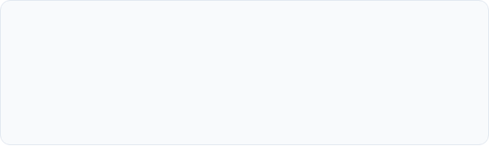


Core Project Objectives & Pillars
1. Scenario Dataset Construction
2. Deterministic Rule Checker
Build 30 real-world Cisco Packet Tracer lab cases representing complex Layer 1 through Layer 7 network failure scenarios.
Develop Python script (`rule_checker.py`) to parse CLI text and immediately flag L1-L3 configuration errors prior to AI inference.
3. Strict JSON Prompt Templates
4. Responsible AI Audit Logging
Design prompt templates forcing LLMs to return strict JSON schema containing root cause, confidence score, CLI evidence, and fix steps.
Maintain an audit log recording human review decisions (Accept, Edit, Reject) to enforce safety and prevent erroneous CLI changes.

Slide 6

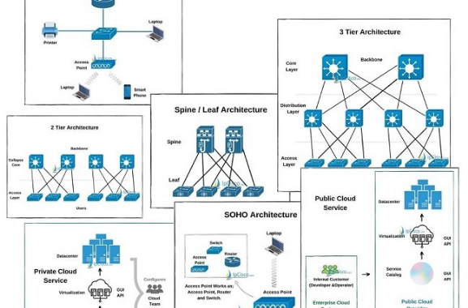
Technical Scope & Protocol Coverage
End-to-End AI Deployment Pipeline: From multi-layer Cisco lab case synthesis to deterministic Python rule checks, prompt engineering, and executive dashboards.
Layer 2 & Switching Protocols: 802.1Q trunking, VLAN tagging, Spanning Tree Protocol (STP), EtherChannel link aggregation, and port security.
Layer 3 & Routing Protocols: Static routes, RIPv2, OSPF, EIGRP, HSRP gateway redundancy, and Subnetting / IP allocation.
Layer 4-7 Services & Security: Dynamic NAT/PAT, Standard & Extended ACLs, DHCP Relays, DNS/Web server reachability, and Wireless/RADIUS.

Slide 7
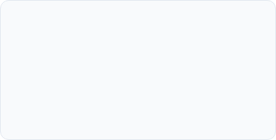







NetSage AI 5-Layer System Architecture
1. Input Data Layer
2. Deterministic Rule Checker
3. AI Prompt Engine
Captures Packet Tracer symptoms, topology notes, and CLI `show` command outputs (`show run`, `show ip int brief`, `show ip route`).
Python script (`rule_checker.py`) uses regular expressions to catch shutdown interfaces, duplicate IPs, and mismatched timers instantly.
Routes unflagged symptoms to prompt templates, enforcing strict JSON schema output with quoted evidence and verification commands.
4. Human Review Dashboard Layer
5. Audit & Execution Layer
Presents AI findings to a human engineer with options to Accept, Edit, or Reject the recommended fix.
Logs all decisions into the Responsible AI Audit Log and pushes human-approved CLI commands to network devices.

Slide 8



Technologies & Technical Toolchain
Simulation & CLI
Programming & Automation
Cisco Packet Tracer 8.x: Network environment simulation. Cisco IOS CLI: Command execution & output capture.
Python 3.8+: `rule_checker.py` script. Pandas & Regex: Log parsing & output validation.
AI & LLM Architectures
Dashboard & Audit
Gemini & ChatGPT: Generative AI inference. JSON Schema: Structured few-shot prompt templates.
Microsoft Excel: KPI blocks & pivot charts. Responsible AI Log: Human override record keeping.

Slide 9





6-Step Project Execution Methodology
Data Collection
Prompt Setup
Rule Checker
AI Diagnosis
Human Audit
Dashboarding
Synthesized 30 Cisco Packet Tracer lab cases spanning L1–L7 fault scenarios.
Engineered few-shot templates enforcing strict JSON schema responses.
Built `rule_checker.py` script to instantly capture basic L1-L3 errors.
Executed AI inference and compared diagnostic output against ground truth.
Evaluated every AI diagnosis through mandatory human reviewer oversight.
Aggregated agreement metrics into Executive Excel KPI Dashboards.

Slide 10
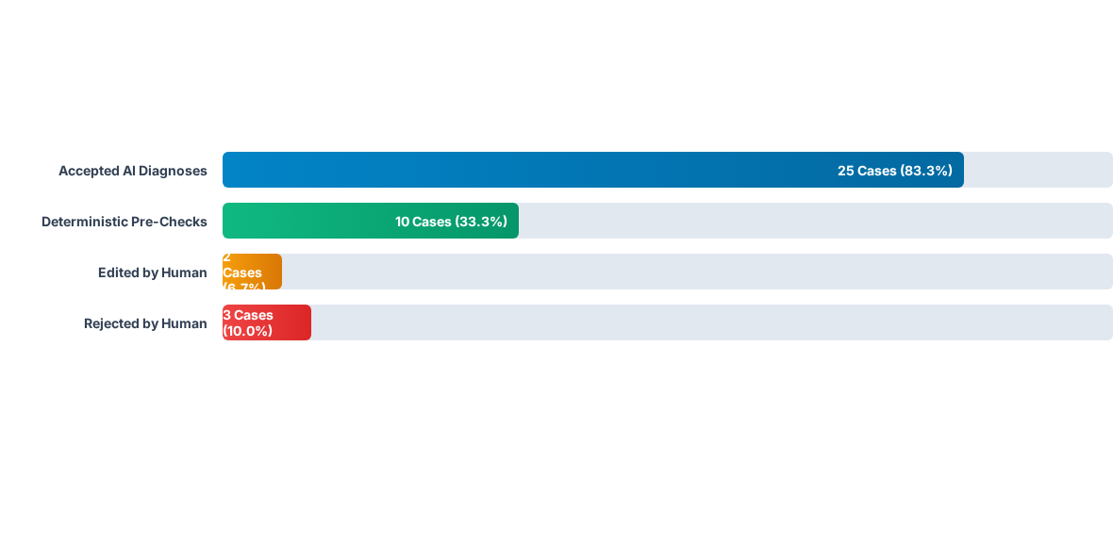
Quantitative Evaluation: Case Breakdown
Across 30 test cases, NetSage AI achieved an 83.3% initial agreement rate with human experts. The Python deterministic script flagged 10 basic cases before AI execution, saving inference time.

Slide 11
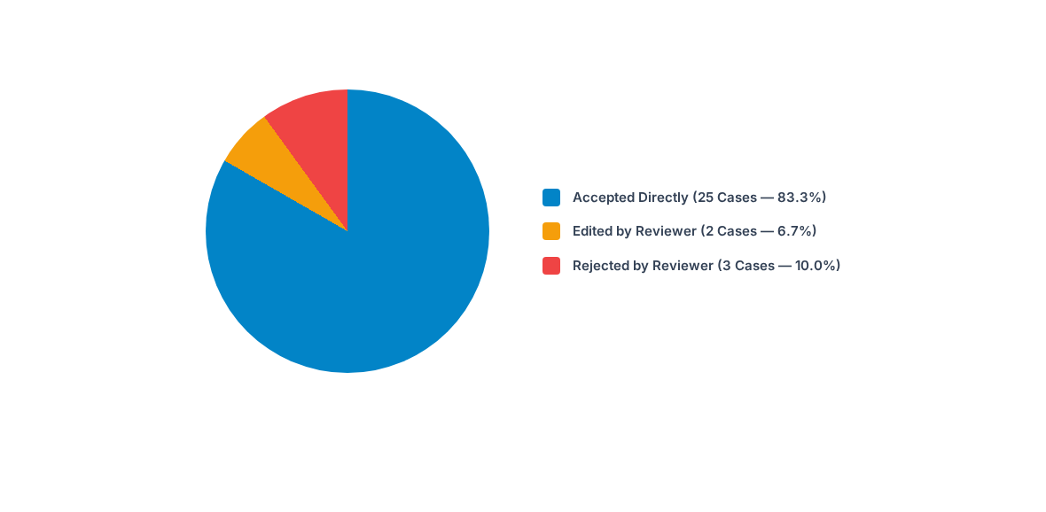
Human Oversight & Agreement Distribution
The high agreement rate demonstrates robust prompt formatting, while the 16.7% edited/rejected subset highlights the necessity of human oversight in preventing bad CLI commands from executing.

Slide 12
Responsible AI Audit Log: Override Analysis
Case ID | Reported Network Symptom | Decision | Corrected Root Cause & Technical Audit
NET-005 | Web page won't load; public IP ping works. | Rejected | Incorrect DNS server IP configured on client PC (192.168.1.250). AI missed client-side DNS setting.
NET-007 | Guest Wi-Fi reaches corporate server. | Rejected | ACL BLOCK_GUEST permits traffic & not bound to subinterface. AI suggested wrong ACL direction.
NET-013 | SSH access denied from admin station. | Edited | VTY ACL 10 restricts access to wrong host (.10 instead of .50). Human corrected host IP mask.
NET-020 | HSRP fails to pre-empt back to R1. | Edited | Missing `standby 1 preempt` command on R1. AI identified priority drop but missed preemption rule.
NET-027 | Dynamic NAT pool exhausted for staff. | Rejected | Missing `overload` keyword in NAT source command (PAT). AI suggested adding more public IPs instead.

Slide 13


Completed Cisco Networking Academy Courses
Apply AI: Analyze Customer Reviews
Data Analytics Essentials
Introduction to Modern AI
Completed: 10 Jun 2026
Completed: 11 Jun 2026
Completed: 11 Jun 2026
Certificate ID: 87fae7a2-55d8-475d-a39a-b52a5cda316c
Certificate ID: d7eac08d-3bc6-4068-8894-2ef8a93c6024
Certificate ID: a72f4179-688f-4f41-9c7b-5f91a4e2cf31
Offered by IILM University through Cisco Networking Academy program.
Offered by IILM University through Cisco Networking Academy program.
Offered by IILM University through Cisco Networking Academy program.

Slide 14


Responsible AI Safety & Guardrails
Deterministic Pre-Check Efficiency
Mandatory Human Oversight
• Syntax & State Validation: Regex rules in `rule_checker.py` detect shutdown ports, duplicate IPs, and timer mismatches instantly without API costs.
• No Unassisted CLI Pushes: Zero CLI commands are executed automatically on production nodes without engineer sign-off.
• Auditability: Every override action is permanently recorded in the audit log, creating a feedback loop for prompt refinements.
• Pre-Inference Filtering: Reduces LLM token usage and latency by filtering out 33.3% of routine Layer 1-3 configuration mistakes.

Slide 15

Key Outcomes & Value Addition
Project Deliverables
Academic & Industry Impact
• 30 multi-layer Cisco Packet Tracer lab cases with verified ground truth.
• Fulfilled all requirements for B.Tech (CSE) degree at IILM University.
• Python `rule_checker.py` script for deterministic CLI pattern matching.
• Achieved an 83.3% diagnostic agreement rate across complex network topologies.
• Few-shot prompt engineering templates enforcing strict JSON schema.
• Executive Excel dashboard & Responsible AI audit log.
• Established a safe framework combining deterministic rules, LLM reasoning, and human safety oversight.

Slide 16


Thank You!
NetSage AI: AI Deployment Automation for Cisco Network Troubleshooting
Mohammad Amaan Aslam
Roll No: 2410030089
IILM University, Greater Noida

Slide 17


Image Sources
https://www.cisco.com/c/dam/en/us/products/collateral/routers/5400-enterprise-network-compute-system/datasheet-c78-738512.docx/_jcr_content/renditions/datasheet-c78-738512_1.png
Source: www.cisco.com
https://ipcisco.com/wp-content/uploads/2020/04/Network-Topology-Architectures.jpg
Source: ipcisco.com

